Slide 1
Configuring the Server
IOS110

Slide 2
Objectives
Use Server Manager to manage a server
Describe Remote Administration
Delegation of Server Administration
Install and remove server roles
Configure server hardware
Configure the operating system
Understand and configure the Registry
Describe Windows PowerShell

Slide 3
Server Manager
Server Manager is a management console in Windows Server® 2012 that helps IT professionals provision and manage both local and remote Windows-based servers from their desktops, without requiring either physical access to servers, or the need to enable Remote Desktop protocol (RDP) connections to each server.
Notes:
http://blogs.technet.com/b/askpfeplat/archive/2012/08/21/welcome-to-server-manager-2012-style.aspx

Slide 4
Server Manager
Manage Local and Remote servers
View and change server configuration
View and change network configuration
Add and Remove Server Roles and Features
Run diagnostics
Manage storage and backups

Slide 5
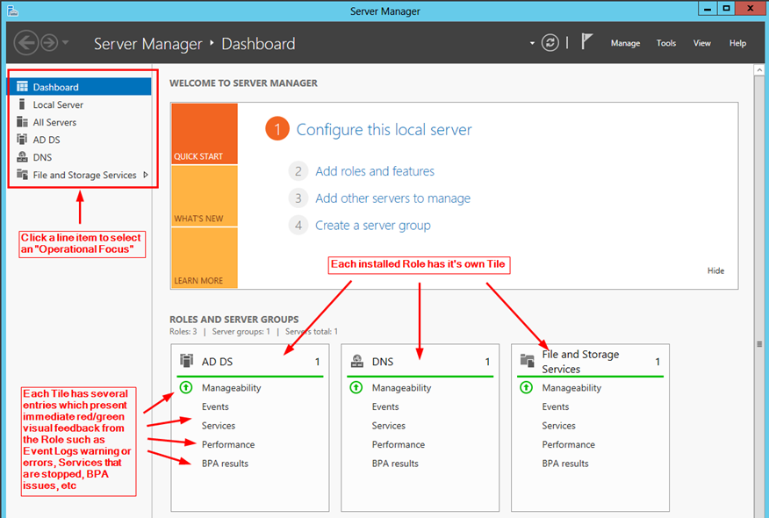
Server Manager
Notes:
http://technet.microsoft.com/en-us/library/jj134147.aspx

Slide 6
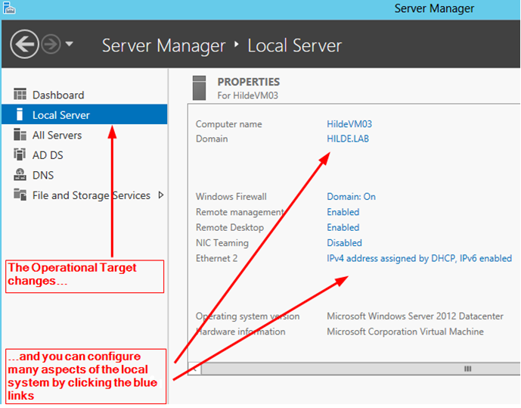
Manage the Local Server
http://blogs.technet.com/b/askpfeplat/archive/2012/08/21/welcome-to-server-manager-2012-style.aspx

Slide 7
Remote Administration and Administering Multiple Servers
The new Server 2012 Server Manager allows easy Remote Administration of Servers and allows you to manage groups of servers.
Remote access must be allowed on the servers that will be remotely administered.
You can group servers together into Server Groups, so related servers can be managed together.
You can use Powershell to perform remote administrative tasks and only Powershell to manage Server Groups.
Notes:
We will not be managing Remote Servers or Multiple Servers in IOS110. We will learning to manage our Local Server only. It is important to know that this can be accomplished with your Server Manager and PowerShell commands.

Slide 8
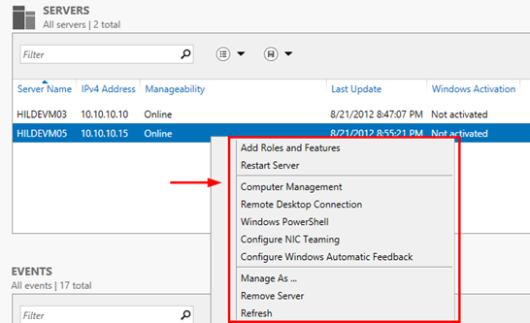
Manage Remote Server(s)
http://blogs.technet.com/b/askpfeplat/archive/2012/08/21/welcome-to-server-manager-2012-style.aspx

Slide 9
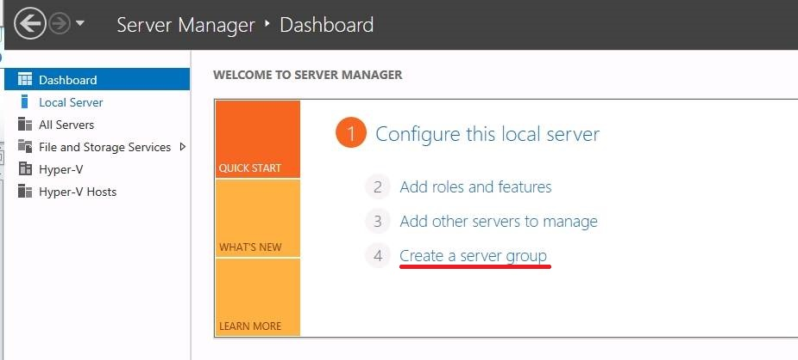
Server Groups
A server group is a collection of physical or virtual servers that perform the same tasks and should be managed or monitored together.

Slide 10
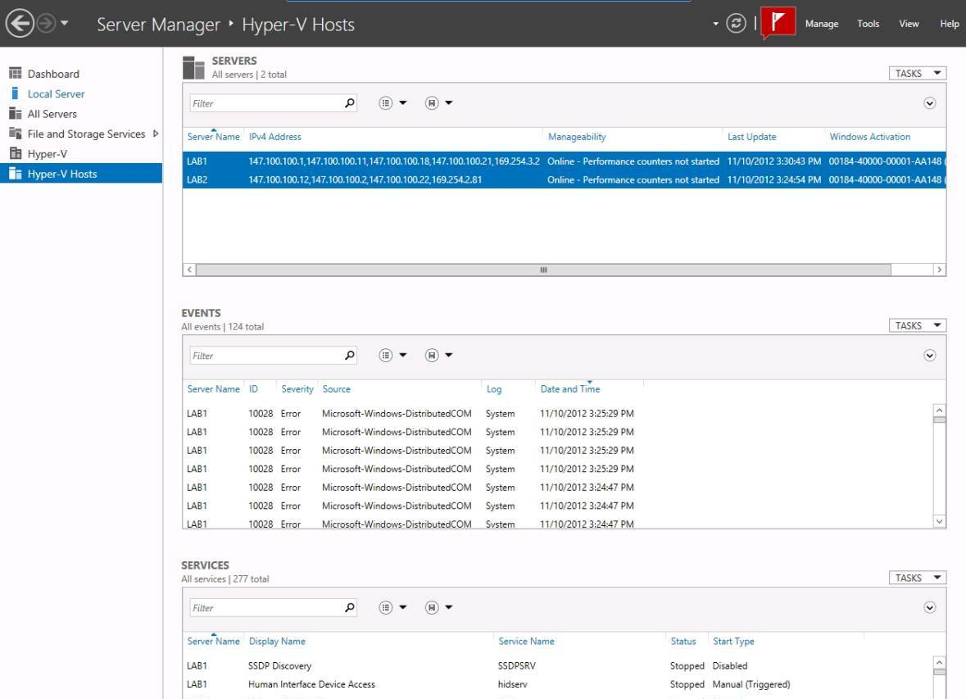
Server Groups
Below you see a Server Group called Hyper-V Hosts
http://searchwindowsserver.techtarget.com/tip/Enabling-multi-server-management-in-Windows-Server-2012

Slide 11
Delegation of Server Administration
Delegation allows Administrators to give SOME Administrative rights to other users.
In large networks, you don’t want too many people having full administrative rights, but there are many tasks that need to be accomplished.
Some server management tasks that might be delegated, include:
Backing up servers
Changing users’ passwords
Management of department print servers
Management of servers at a remote location
When delegating administrative rights, give the minimum rights necessary to perform the task
Notes:
On smaller networks, with small IT staffs, it is common for task delegation to be informal, and for everyone in the IT department to have full access to the entire network. However, on larger networks, with larger IT staffs, this becomes increasingly impractical. Delegation, therefore, is the practice by which administrators grant other users a subset of the privileges that they themselves possess.
On larger networks it is good practice to limit full administrator access to a very small number of people and grant others a subset of privileges. Examples:
You may have a person whose sole responsibility is to help users who have forgotten their passwords. They would have the ability to change passwords, but not be a full administrator.
Frequently, a user or group of users, are given the rights to perform backups. This ensures that backups are completed, but these users don’t have any additional administrative power.
You can also have people who have administrative privileges to only a certain area of a company. If you have an office in a remote location, with limited staff, you may want to have a local person have administrative privileges over just that location, but not any computers at another location.

Slide 12
Configuring Server Hardware Devices
Hardware devices can include the following:
Disk drives
Disk controllers
Network adapters
CD/DVD drives
Keyboard
Pointing devices
Monitor

Slide 13
Plug and Play
Plug and Play (PnP)
The ability to automatically detect and configure newly installed hardware devices
For this capability to work, PnP must be:
Built into the device
Enabled in the target computer’s BIOS
Built into the computer operating system kernel

Slide 14
Control Panel and the Add Hardware Wizard
The Add Hardware Wizard is used for the following tasks:
Invoke the operating system to use PnP to detect new hardware
Install new non-PnP hardware and hardware drivers
Troubleshoot problems you might be having with existing hardware

Slide 15
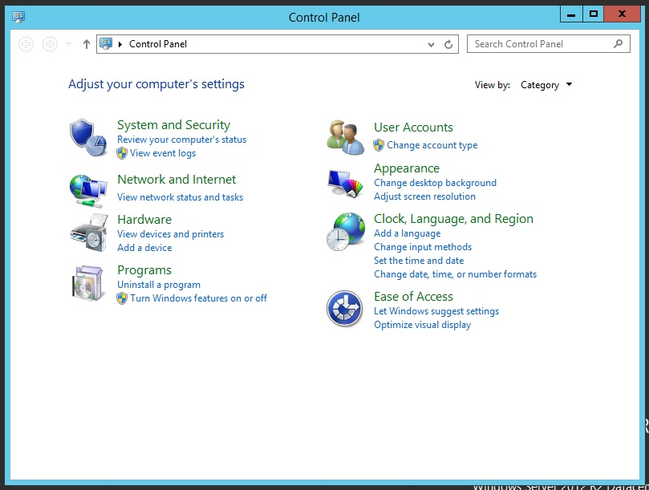
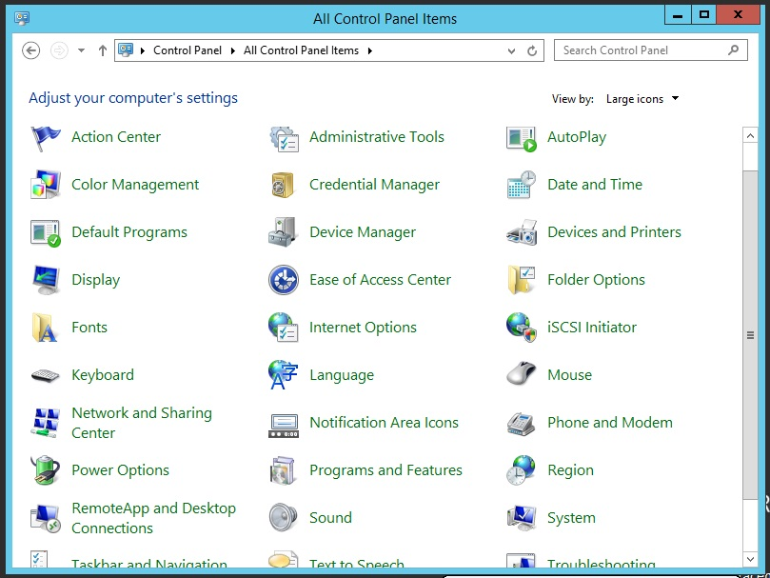
Control Panel

Slide 16
Device Manager
Used to check for a resource conflict and to examine other properties associated with a device
Provides a graphical view of all hardware currently installed on your computer
Can also be used to:
Verify if hardware installed is working properly
Update device drivers
Disable a device
Uninstall a device
Configure the settings for a device

Slide 17
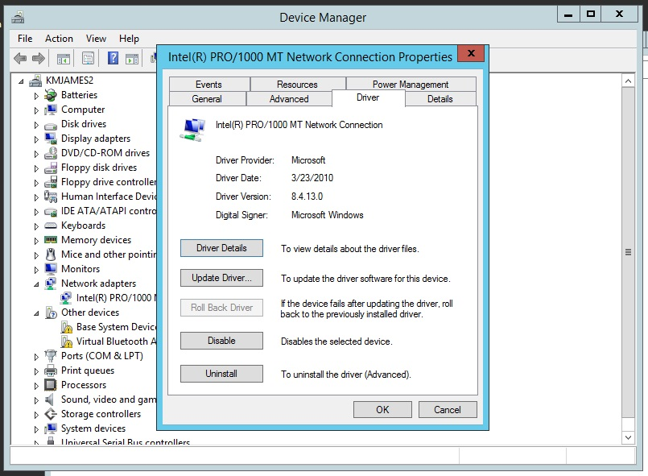
Device Manager

Slide 18
Configuring the Operating System
Configure the server to optimize performance
Processor scheduling
Virtual memory

Slide 19
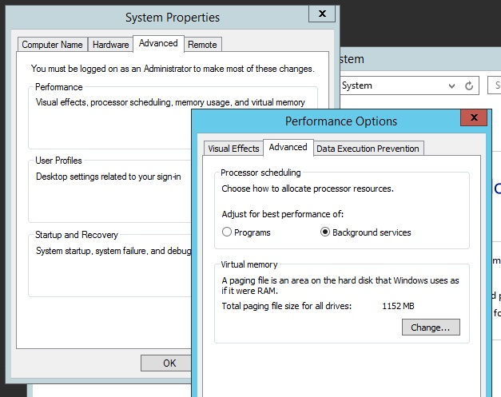
Optimizing Performance

Slide 20
Processor Scheduling
Allows you to configure how processor resources are allocated to programs
ie. Foreground and background processes
Servers, by default, give a higher priority to background processes.
Foreground applications on your server can be made to run faster by temporarily giving higher priority to foreground processes.

Slide 21
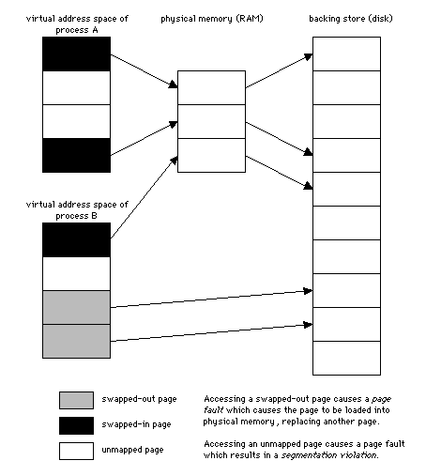
Virtual Memory
Disk storage used to expand the capacity of the physical RAM installed in the computer
works through a technique called paging
blocks of information, called pages, are moved from RAM into virtual memory on disk, and back again
The area of disk that is allocated for this purpose is called the paging file

Slide 22
Tips for placement of the paging file:
Server performance is better if the paging file is not placed on the boot partition
If there are multiple disks, performance can be improved by placing a paging file on each disk
In a mirrored set or volume, place the paging file on the main disk
Do not place the paging file on a stripe set, striped volume, stripe set with parity, or RAID-5 volume
Initial paging file size should be at least 1.5 times the RAM size

Slide 23
Windows Server Registry
A very complex database containing all information the operating system needs about the entire server
Use regedt32 or regedit to start the Registry Editor to make changes directly to the registry

Slide 24
Windows Server Registry
Data contained in the Registry include:
Information about all hardware components
Information about Windows Server services that are installed
Data about user profiles and Windows Server group policies
Data on the last current and last known setup used to boot the computer
Configuration information about all software in use
Software licensing information
And much more……

Slide 25
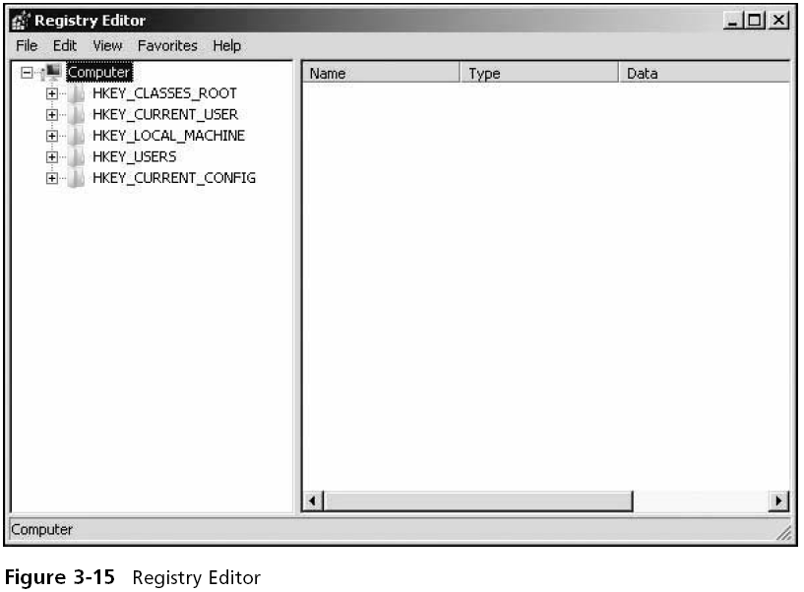
Registry Editor (regedit)

Slide 26
Windows Server Registry
Precautions when working with the Registry:
Establish a specific group of administrators who have privileges to open and modify the Registry
Only make changes to the Registry as a last resort
Graphical configuration tools should always be used, if than can be used.
Regularly back up the Registry as part of backing up the Windows Server Windows folder
Never copy the Registry from one Windows-based system over the Registry of a different system

Slide 27
Registry Contents
The Registry is hierarchical in structure (similar to a directory structure)
Made up of keys, subkeys, and entries/values
Registry key
A category or division of information within the Registry
Registry subkeys
A single key may contain one or more lower-level keys
Registry entry/value
A data parameter associated with a software or hardware characteristic under a key (or subkey)

Slide 28
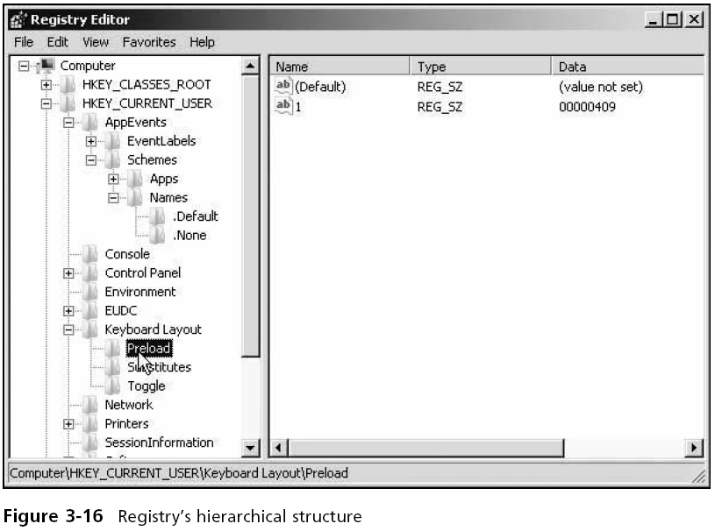
The Registry’s Hierarchical Structure

Slide 29
HKEY_LOCAL_MACHINE
HKEY_LOCAL_ MACHINE root key
Contains information on every hardware component in the server
Including information about what drivers are loaded and their version levels, what IRQ lines are used, setup configurations, the BIOS version, and more

Slide 30
HKEY_CURRENT_USER
HKEY_CURRENT_USER key
Contains information about the desktop setup for the account presently logged on to the server console

Slide 31
HKEY_USERS
HKEY_USERS root key
Contains profile information for each user who has logged onto the computer
Each profile is listed under this root key

Slide 32
HKEY_CLASSES_ROOT
HKEY_CLASSES_ROOT key
Holds data to associate file extensions with programs
Associations exist for executable files, text files, graphics files, Clipboard files, audio files, and many more
These associations are used as defaults for all users who log on to Windows Server

Slide 33
HKEY_CURRENT_CONFIG
HKEY_CURRENT_CONFIG root key
Has information about the current hardware profile
Holds information about the monitor type, keyboard, mouse, and other hardware characteristics for the current profile

Slide 34
Windows PowerShell
PowerShell is now the preferred method for Windows Server Configuration and Management
Any configuration or management task that can be done through a GUI tool, can also be accomplished with PowerShell
Some server configuration and management tasks can ONLY be done with PowerShell (such as Server Group Administration)

Slide 35
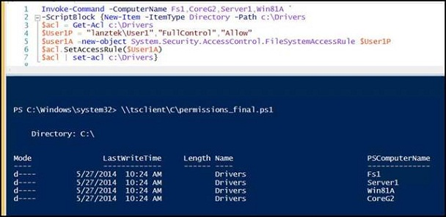
PowerShell example
You need to create a folder on each computer to store drivers and, at the same time, you want to assign full control permission to a domain user, named User1, to access the folder. The following image shows the script that you would run in PowerShell to accomplish this remote administration on multiple servers:
http://www.windowsnetworking.com/articles-tutorials/windows-server-2012/remote-management-powershell-part1.html
Notes:
You do not need to understand this example for the IOS110 course. Just have a look at the image. If you would like to know more, you can visit the URL listed on the slide and here:
http://www.windowsnetworking.com/articles-tutorials/windows-server-2012/remote-management-powershell-part1.html

Slide 36
Summary
Server Manager consolidates administrative functions to make a local or remote server easier to manage
Device Manager is a tool you can use to manage hardware
After Windows Server is installed, you can tune performance by configuring processor scheduling and virtual memory.
The Registry is a database contains all of the configuration information for your Windows Server
Windows PowerShell is a command-line tool that enables a system administrator to manage a server using commands, cmdlets, and scripts

